Slide 1

CLUSTER ANALYSIS
Creating Clusters on Global Development measurement dataset

Slide 2
PROJECT WORKFLOW
MANUAL INSPECTION
EDA (EXPLORATORY DATA ANALYSIS)
FEATURE ENGINEERING
MODEL BUILDING
MODEL EVALUATION
MODEL DEPLOYMENT

Slide 3
ABOUT DATASET
Birth Rate
The number of live births per thousand of population per year.
Business Tax Rate (%)
A levy placed by government to a firms profit
CO2 Emissions
Carbon dioxide emission per capita
Country
Name of Country
Days to Start Business
The number of days needed to complete the procedures to legally operate a business
GDP ($)
Gross Domestic Product
Health Exp % GDP
Percentage of GDP spent on Health care
Health Exp/Capita
Health expenditure per capita
Hours to do Tax
The time, in hours per year, it takes to prepare, file, and pay three major types of taxes
Infant Mortality Rate
the number of deaths per 1,000 live births of children under one year of age
Internet Usage
Percentage of Countrys population using internet
Lending Interest
The proportion of a loan that is charged as interest to the borrower, typically expressed as an annual percentage of the loan outstanding.
Life Expectancy Female
The average period that a female may expect to live.
Life Expectancy Male
The average period that a male may expect to live.
Mobile Phone Usage Percentage of cell phone users
Population 0-14
Percentage of Population between
0-14 years of age.
Population 15-64
Percentage of Population between 15-64 years of age.
Population 65+
Percentage of Population above 65 years of age
Population Total
Total of overall population
Of Country
Population Urban
Percentage of urban population
Tourism Inbound
The tourism spending of visitors who are not residents of that country
Tourism Outbound
The tourism spending of residents of certain country to another country
Ease of doing business rank from 1 - 190 (1 = most business-friendly regulation)
Energy Usage
Energy consumption of a country

Slide 4
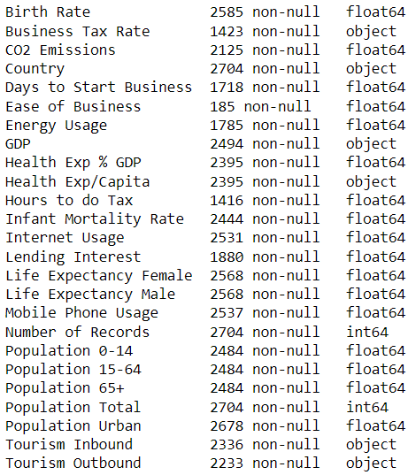


ABOUT DATASET
There are total 2704 rows and 25 columns.
Business Tax Rate, GDP, Health Exp %,GDP, Health Exp/Capita, Tourism, Inbound and Outbound are numerical columns but are represented as object as these columns contain % and $ symbols.
There are no duplicate entries in the entire dataset.

Slide 5
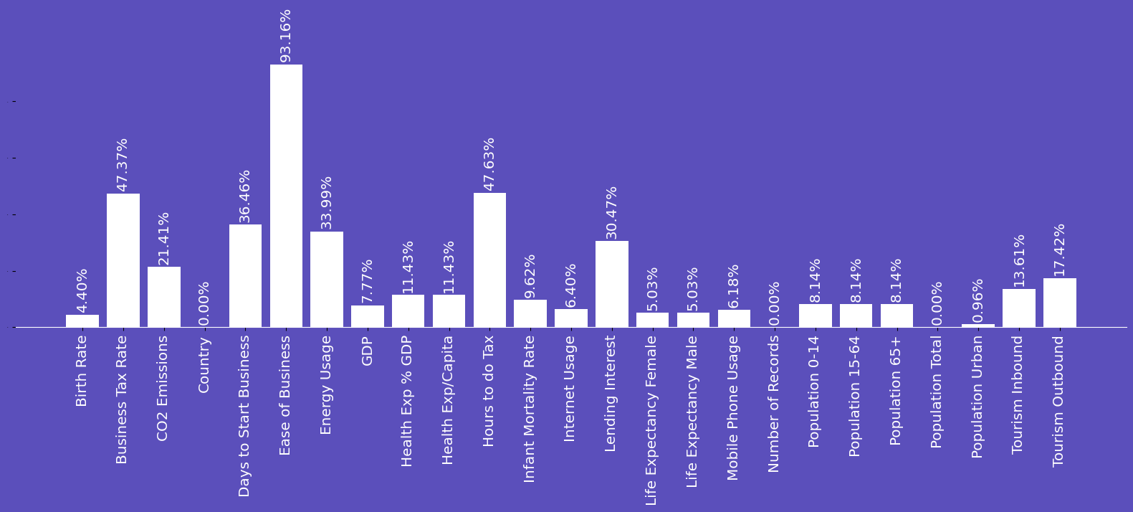
ABOUT DATASET
% of missing values in each column
Ease of Business has around 93% missing value and imputing these missing values will make no sense so, the column will be dropped.
Rest of the columns which missing values can be imputed after analysing the data more.

Slide 6
DESCRIPTIVE STATISTICS
 | Birth Rate | Business Tax Rate | CO2 Emissions | Days to Start Business | Ease of Business | Energy Usage | GDP | Health Exp % GDP | Health Exp/Capita | Hours to do Tax | Infant Mortality Rate | Internet Usage | Lending Interest
mean | 2% | 49% | 142307.1 | 40.00 | 94.88 | 77236.8 | $ 2,63,85,40,42,324 | 6% | $ 801.40 | 302.07 | 3% | 24% | 15%
std | 1% | 41% | 615928.8 | 57.32 | 54.79 | 259923.9 | $ 11,29,91,03,23,899 | 3% | $ 1473.45 | 273.30 | 3% | 26% | 17%
min | 1% | 8% | 7 | 1 | 1 | 8.000 | $ 6,31,01,272 | 1% | $ 2 | 12 | 0% | 0% | 1%
25% | 1% | 32% | 1360 | 13 | 48 | 3737 | $ 3,53,90,42,241 | 5% | $ 50 | 156 | 1% | 0% | 8%
50% | 2% | 41% | 8529 | 26 | 94 | 14338 | $ 15,07,97,52,558 | 6% | $ 193 | 239 | 2% | 10% | 12%
75% | 3% | 52% | 59108 | 45 | 142 | 41852 | $ 1,10,20,46,92,644 | 8% | $ 665 | 344.75 | 5% | 40% | 17%
max | 5% | 339% | 8286892 | 694 | 189 | 2727728 | $ 1,62,44,60,00,00,000 | 23% | $ 9908 | 2600 | 14% | 100% | 497%
Business Tax Rate, lending Interest Rate are % Column but have max values above 100%
Hours to do Tax has max value as 2600 which mean it takes approx. 3.5 months to do tax for some countries and is quite high time
Ease of Business has only 185 entries of 2704 so this column will be dropped as synthetic imputed data might not be accurate for 93% values
Most of the Columns here seems to have outliers we will confirm it using graphical plots

Slide 7
DESCRIPTIVE STATISTICS
 | Life Expectancy Female | Life Expectancy Male | Mobile Phone Usage | Number of Records | Population 0-14 | Population 15-64 | Population 65+ | Population Total | Population Urban | Tourism Inbound | Tourism Outbound
mean | 71% | 66% | 58% | 1 | 30% | 62% | 7% | 31457293.89 | 56% | $ 4,93,93,20,248 | $ 4,72,94,34,796
std | 11% | 9% | 47% | 0 | 11% | 7% | 5% | 124289389.9 | 25% | $ 13,85,09,84,281 | $ 13,26,77,38,529
min | 39% | 37% | 0% | 1 | 12% | 47% | 0% | 18876 | 8% | $ 7,00,000 | $ 2,00,000
25% | 64% | 61% | 10% | 1 | 20% | 56% | 3% | 878336 | 36% | $ 12,50,00,000 | $ 11,00,00,000
50% | 75% | 69% | 50% | 1 | 30% | 64% | 5% | 5800324.5 | 56% | $ 68,85,00,000 | $ 45,60,00,000
75% | 79% | 73% | 90% | 1 | 40% | 68% | 11% | 20140891.75 | 77% | $ 3,60,15,00,000 | $ 2,84,20,00,000
max | 87% | 88% | 290% | 1 | 50% | 86% | 24% | 1350695000 | 100% | $2,00,09,20,00,000 | $1,26,57,30,00,000
Mobile Phone Usage is % Column but has max values above 100%
Number of Records is a constant column and has 0 variance which will not contribute to the clustering model
To check the accuracy of the given data it was cross checked with reputed sources like UN DATA and WORLD BANK DATA and the values were accurate
Even though the values matched the sources, % value cannot be over 100% for certain columns which means there could be potential data entry error. So, will try to handle these while doing featuring Engineering
Most of the Columns here seems to have outliers we will confirm it using graphical plots

Slide 8
DESCRIPTIVE STATISTICS
Country Column has 208 Unique Country Names
The Frequency for each Country is 13
As Each Country has 13 entries so these 208 Unique Countries make 2704 entries in total, which is equal to the total number of rows in dataset
It can be concluded that this dataset has entry for over 13 years span
To confirm this hypothesis the data was cross checked with WORLD BANK DATA and the values matched for years between 2000 and 2012
This also indicates that each row represent 1 country for 1 year
Using this information a new column named year can be formed
Country
Count | 2704
Unique | 208
Top | Algeria
Freq | 13

Slide 9
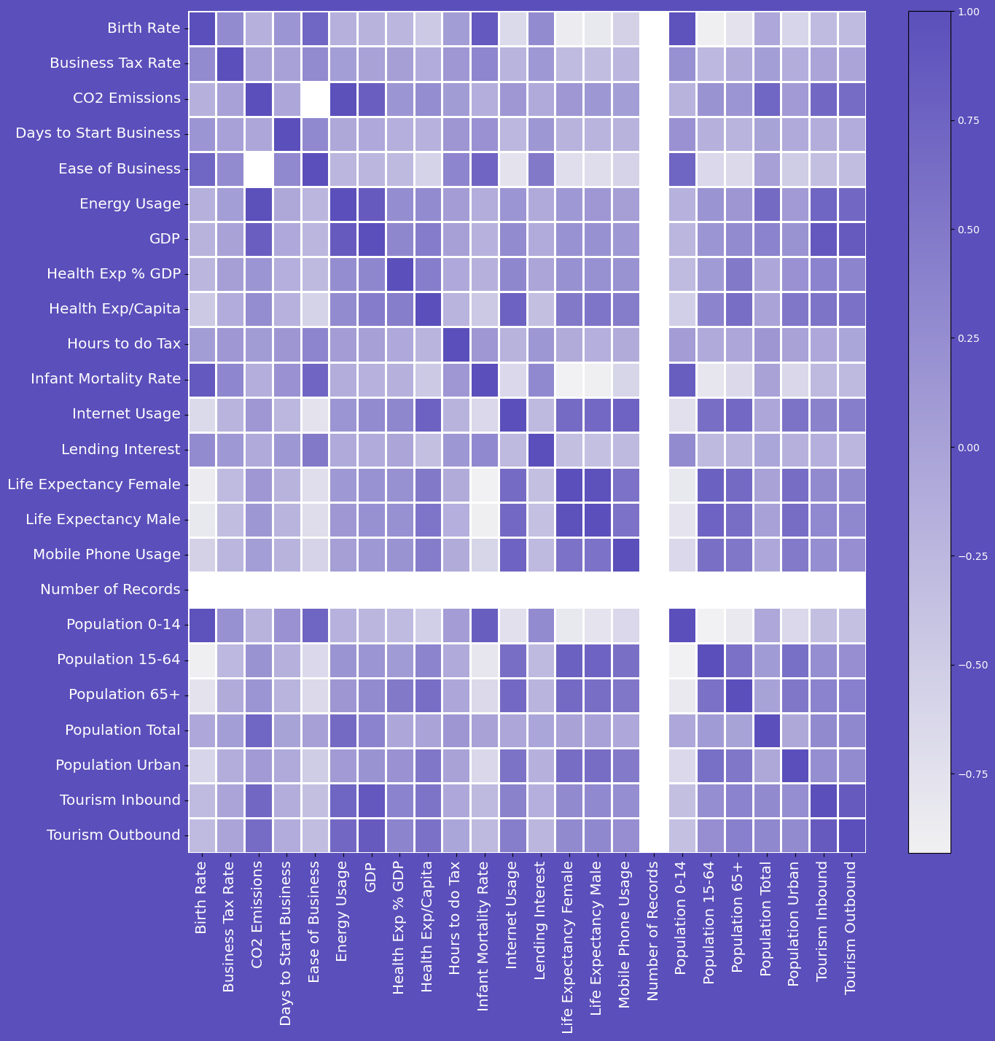
CORRELATION ANALYSIS
Darker shades indicate stronger positive correlations, suggesting that as one variable increases, the other tends to increase as well.
Lighter shades signify weaker positive correlations,
White shades represent negative correlations, indicating an inverse relationship between variables.
The intensity of the color reflects the strength of the correlation. Darker colors indicate stronger relationships, while lighter colors represent weaker correlations.
These correlation information can be used to impute the missing values in certain columns.

Slide 10
MISSING VALUES IMPUTATION APPROACH
With 208 countries in the dataset, a global mean or median imputation approach may not accurately represent the unique variations in each country's statistics.
Country-specific imputation strategy by grouping countries based on their individual characteristics can be used.
As the data spans for 13 years, temporal trends can be used for imputation using backward fill and forward fill methods.
Identifying columns with high correlation and using them for imputation, treating the missing value column as the target and correlated columns as dependent variables.
If there are any missing values in any of the columns would later be imputed using KNN-Imputer

Slide 11
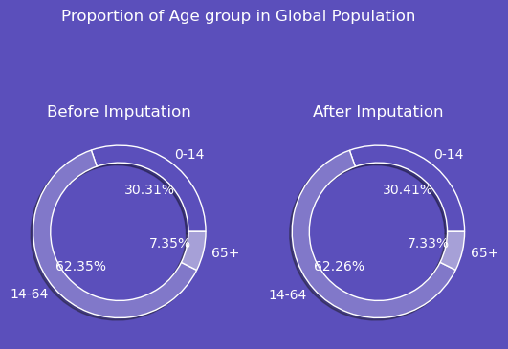
MISSING VALUE IMPUTATION
For Population representing columns
Analysed the Global mean proportion for each category of population age group
Most of the Countries Proportion over 13 years was approx. equal to the Global Proportion Of these age groups
Population age group 0-14 was imputed with random number between 30-35%
Population age group 15-64 was imputed with random number between 60-65%
Population age group was imputed by subtracting Age group 0-14 and age group 15-64 from 100%

Slide 12
MISSING VALUE IMPUTATION
Birth Rate, Business Tax Rate, CO2 Emissions, Days to Start Business, Energy Usage, GDP, Health Exp % GDP, Health Exp/Capita, Hours to do Tax, Infant Mortality Rate, Internet Usage, Lending Interest, Life Expectancy Female, Life Expectancy Male, Mobile Phone Usage, Tourism Inbound, Tourism Outbound these columns were Imputed using the backward fill and forward fill to capture the trend of each country
Countries with No value for all the years in any column still has missing values
Birth rate is correlated with Population age groups and Population total, so it was imputed using Random forest regressor by keeping correlated columns with birth rate as independent variables
St. Martin (French part), St. Martin (French part), Turks and Caicos Islands, Isle of Man, Sint Maarten (Dutch part) have missing values in almost all the columns except 4 columns. Imputing the values for these country would not represent the Country's True statistics so was dropped from the data
Mobile Phone Usage and Population urban has missing value only for country named Kosovo so these columns for this country was imputed using the global median of these two columns
Infant mortality rate was correlated with Birth Rate, Life Expectancy Male, Life Expectancy Female, Population 15-64, Population Urban, Population 0-14,Mobile Phone Usage so was imputed using Random Forest Regressor.
While rest all columns had missing values at random so imputing these columns using regression technique was not possible as its correlated columns also has missing values, so the rest of missing values were imputed using KNN-Imputer

Slide 13
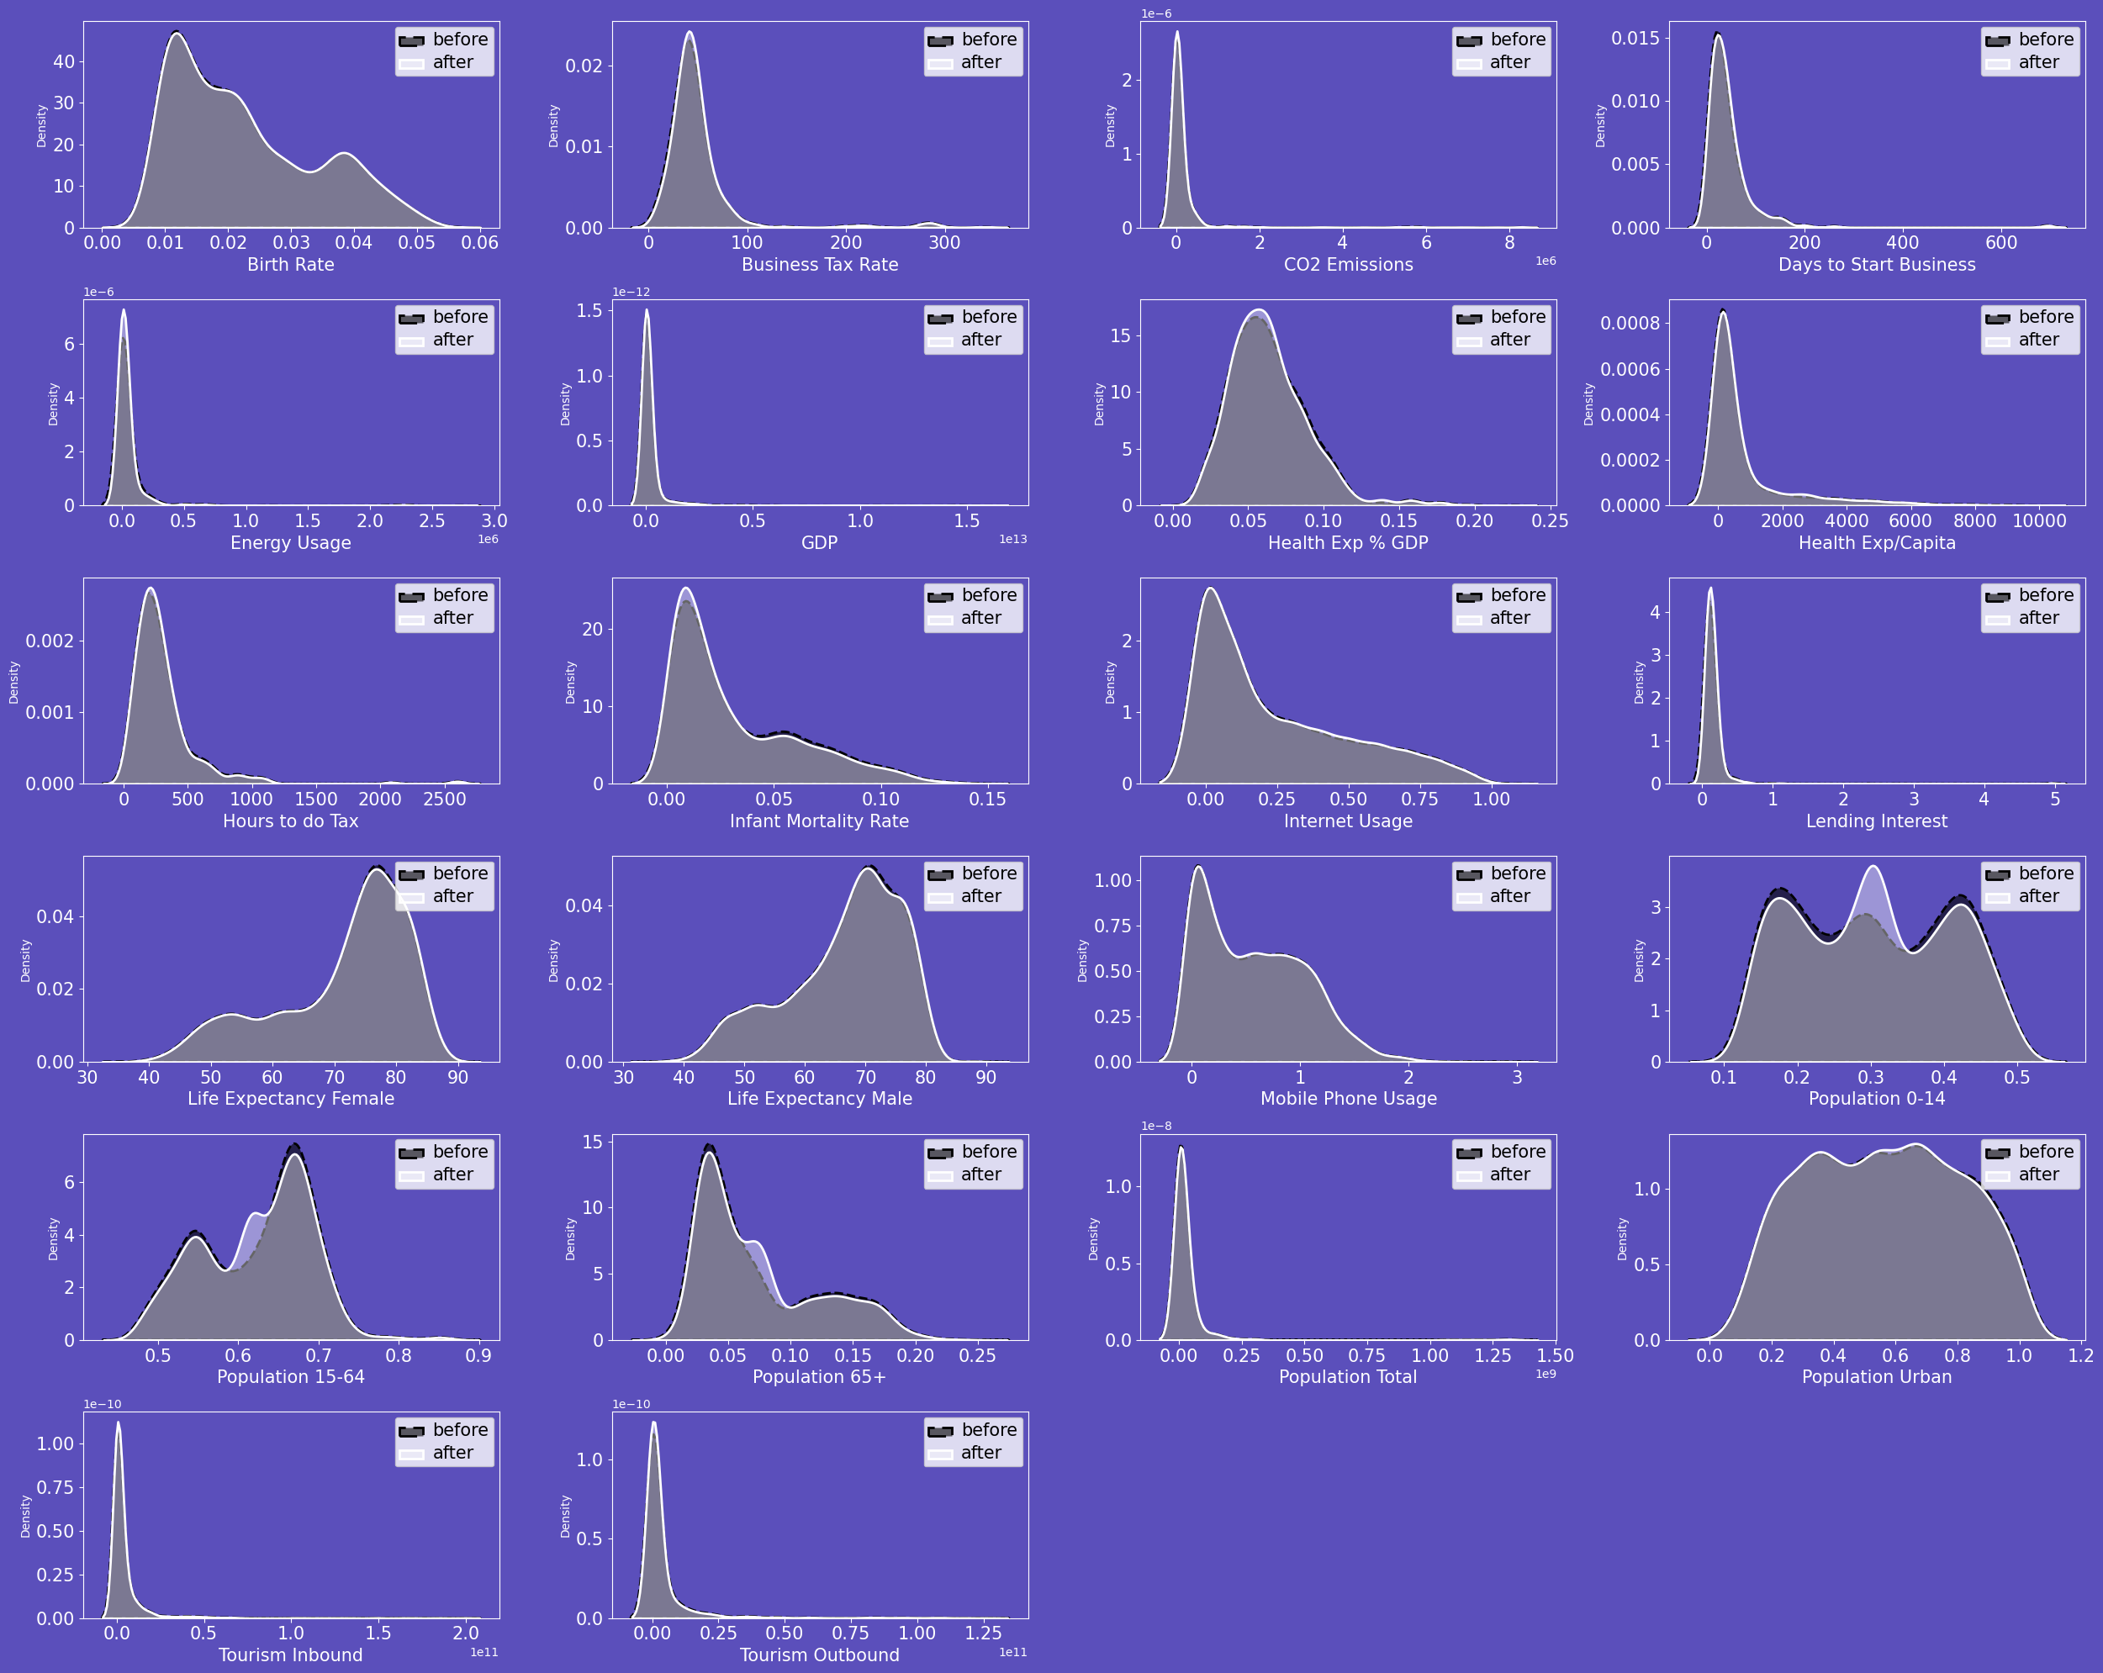
DISTRIBUTION OF COLUMNS BEFORE AND AFTER IMPUTATION

Slide 14
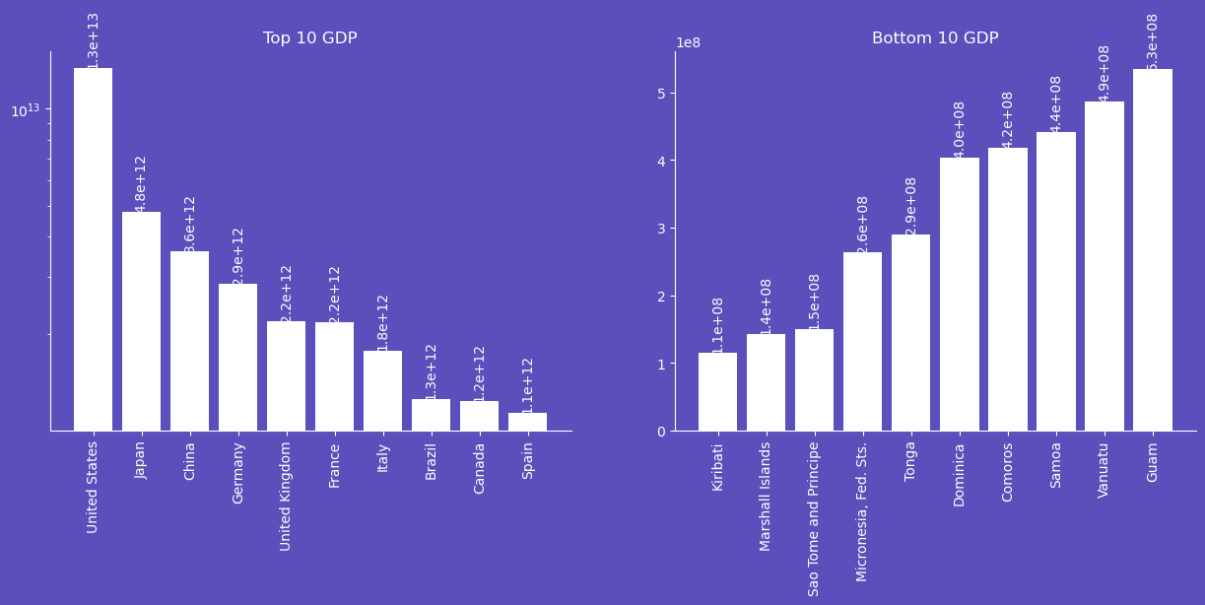
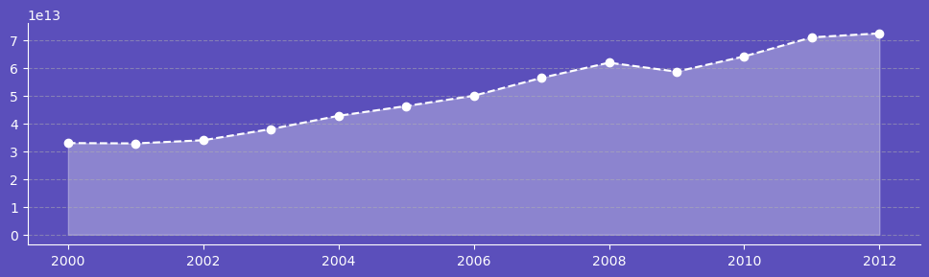
DATA ANALYSIS
GDP
United States has the highest mean GDP for 13 years
Kiribati has the lowest mean GDP for 13 years
The Global trend for 13 years is an upward trend
In year 2009 the global GDP dropped down a bit because of the economic crises in 2009

Slide 15
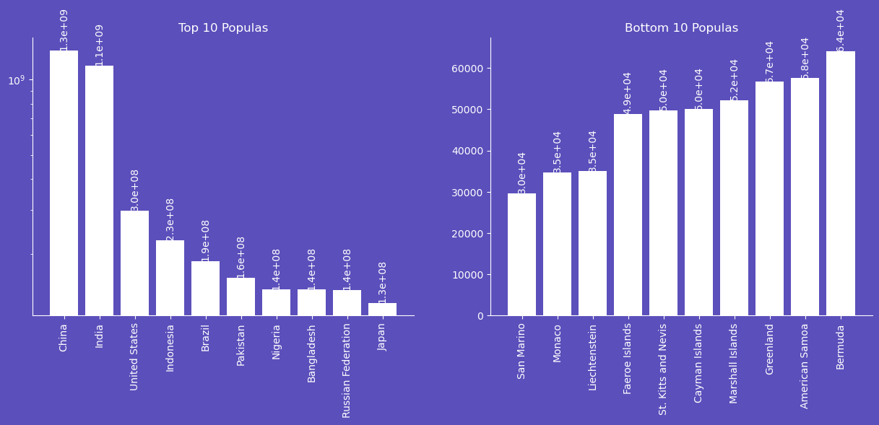
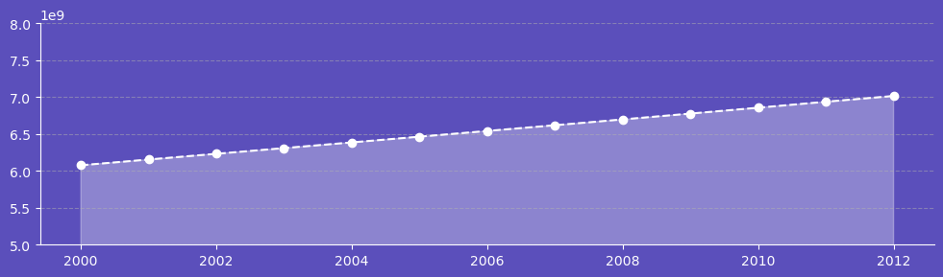
DATA ANALYSIS
Population Total
China is the most Populus Country
San Marino is the least Populus Country
The Global trend for 13 years is an upward trend
There is a linear increase in the World Population over 13 years span

Slide 16
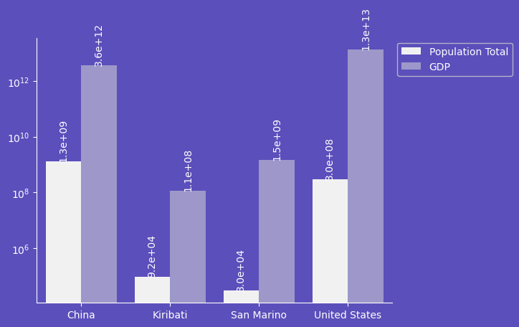
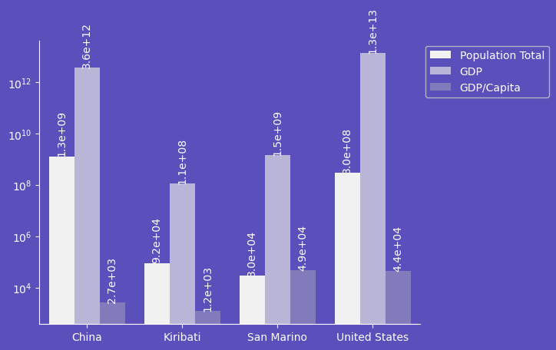
DATA ANALYSIS
Population and GDP Comparison
In figure1 We Compared the Country With the Top and Bottom GDP and Country With Highest And Lowest Population
Here we can see America has 13T of GDP but has Population less than that of China, same goes for Kiribati as it has Population greater than San Marino but has lower GDP than that of San Marino
So, we can see that higher Population doesn’t mean higher GDP and vice versa
To Quantify the proper relation between GDP and Population we created a new metric GDP/Capita
In fig 2, we can see San Marino has higher GDP/capita than that of China and America even being smaller in sense of Population and GDP

Slide 17
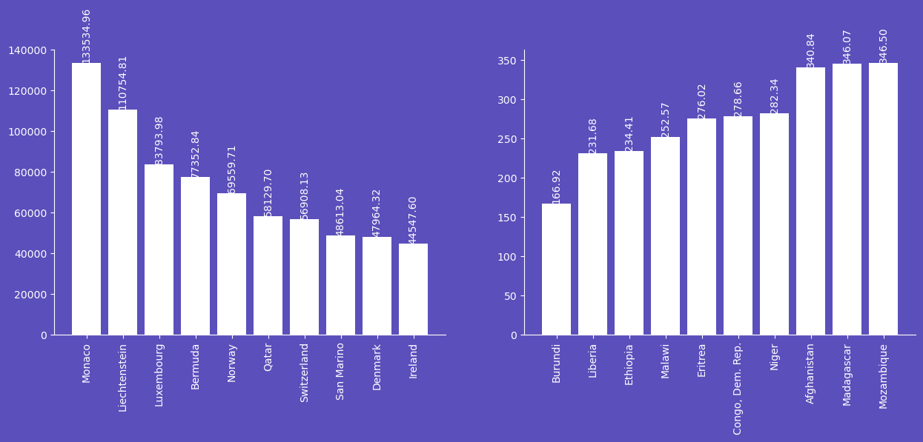
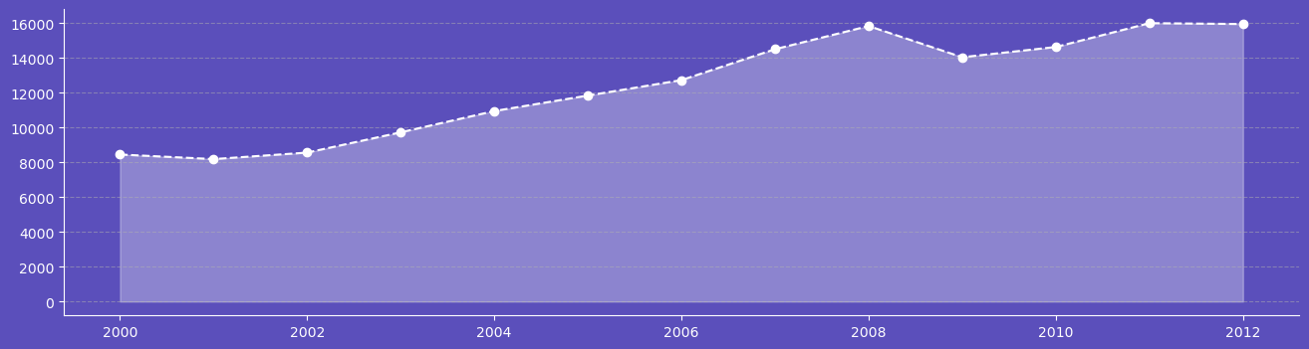
DATA ANALYSIS
Top 10 GDP/Capita
Bottom 10 GDP/Capita
GDP/Capita
GDP/Capita is a metric that measures a country's economic output / person
Monaco has the Highest GDP/Capita whereas Burundi has the lowest GDP/Capita
In the line chart we can see that in 2008 the GDP/Capita was the all-time high which dipped down in 2009. but in year 2011 and 2012 the GDP/Capita couldn't cross 2008s value even though the GDP was at all-time high in 2011 and 2012 respectively
The person Contribution towards country’s GDP hasn’t changes even when the GDP is changed because the Population also grew resulting more people contributing

Slide 18
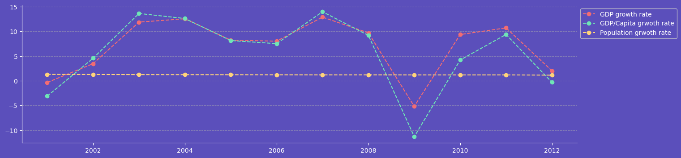
DATA ANALYSIS
Growth Rates
Calculated the Year-on-year Growth Rate for GDP , GDP/Capita and Population Total
The Population changed constantly for around 1% every year
The GDP and GDP/Capita changed almost identically to each other Both metric saw as strong Positive change 12% from year 2002 to 2003 and from year 2006 and 2007
These 2 metric even saw the negative growth in the year 2009 because of the economic crises

Slide 19
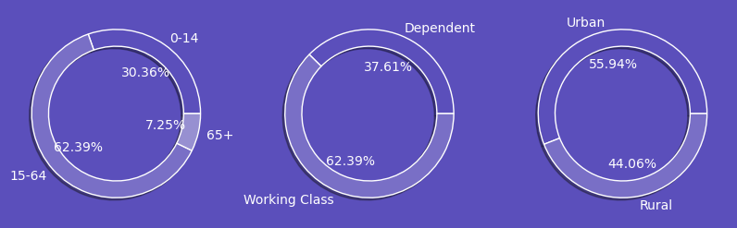
DATA ANALYSIS
Age group Distribution
Dependency ratio
Urban vs Rural
The Age Group distribution tells that the mean global percent of people between age 15-64 group are more and people above 65 are less
The Dependency ratio is calculated by assuming that age group 0-14 and 65+ are the dependent citizen of the Country and people between age 15-65 are the ones who are working and are contributing the country’s economy
On global level most of the population is living in urban area compared to rural areas

Slide 20
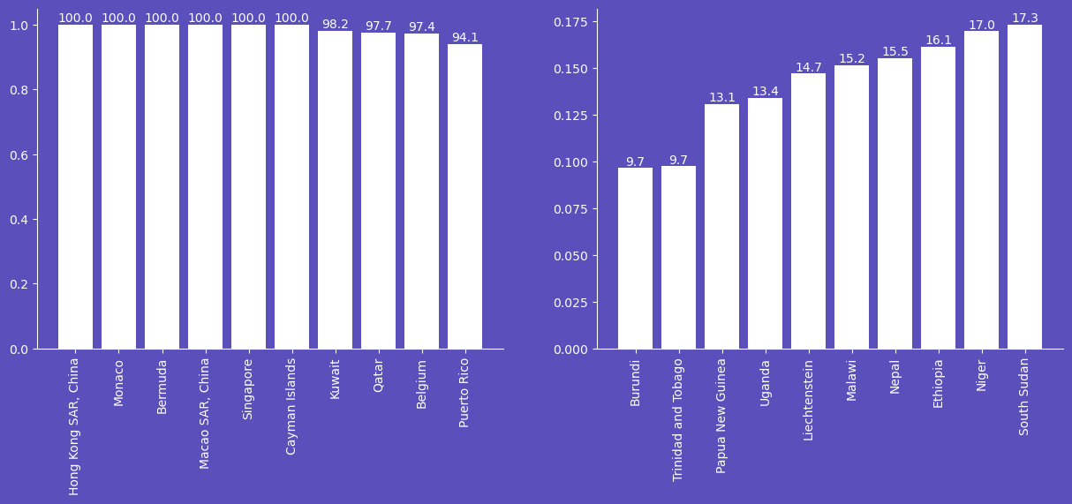
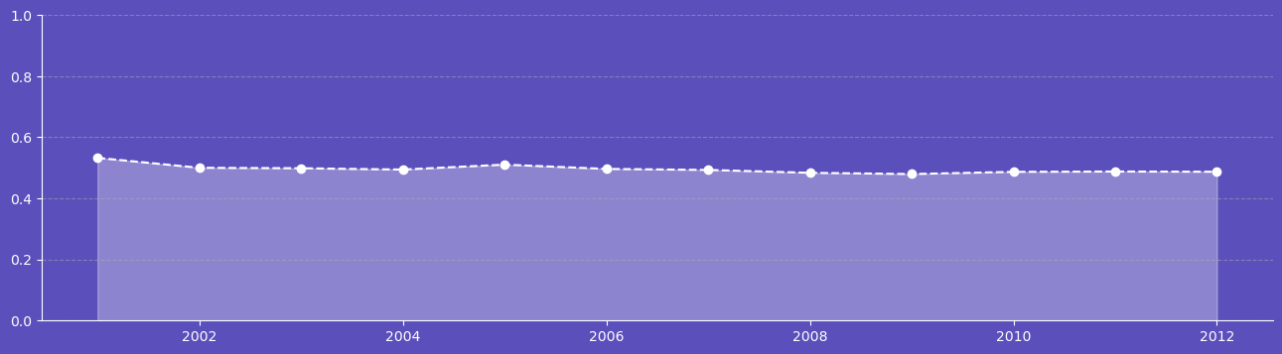
DATA ANALYSIS
Top 10 Urban
Top 10 Rural
Urban Population
The counties like Hong Kong , Monaco, Bermuda, etc are the countries where 100% population lives in Urban areas
Burundi is the country where Most almost 90% population lives In rural area
People moving from rural to urban shows a constant growth around 0.5% people move from rural to urban
Population Growth over year in urban region

Slide 21
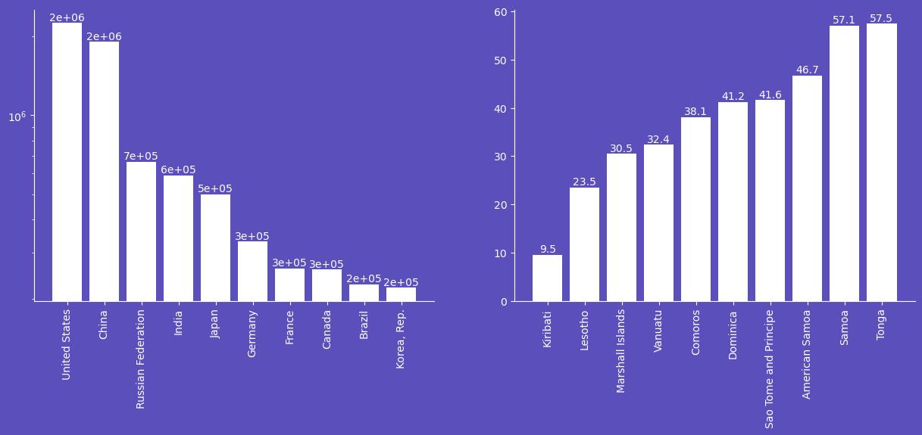
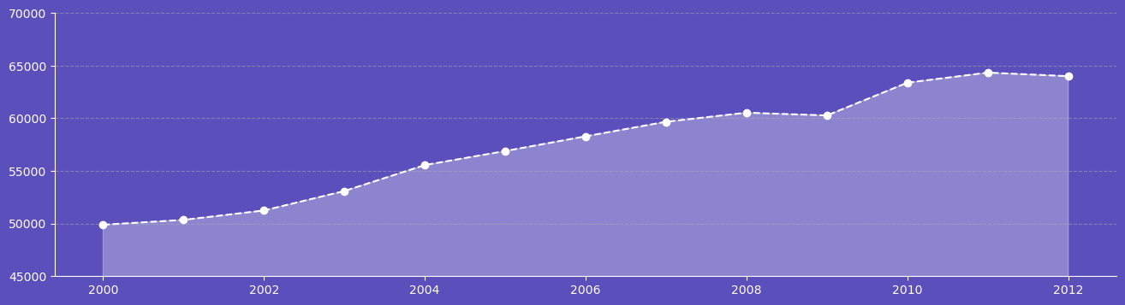
DATA ANALYSIS
Top 10 Energy User
Bottom 10 Energy user
Energy Usage
United States and China are the biggest user of energy
While Kiribati is the country which uses only 9.5 units of energy a year T
The Energy Usage has also been increasing every year
Energy Usage over years

Slide 22
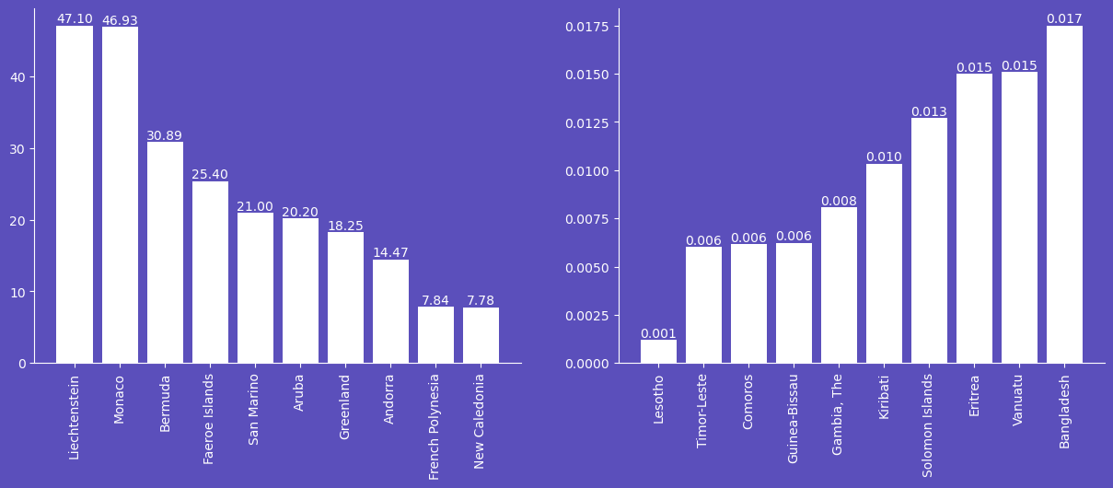
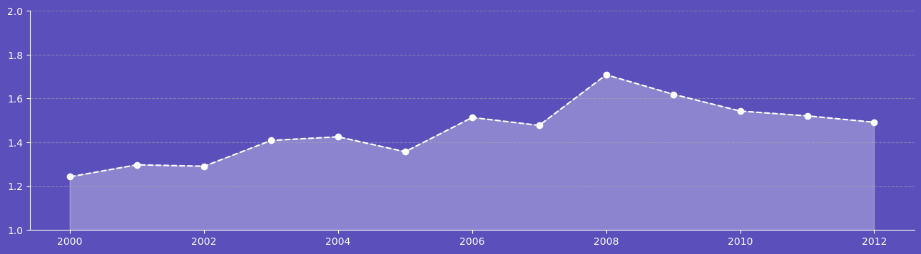
DATA ANALYSIS
Top 10 Energy/Capita User
Bottom 10 Energy /Capita user
Energy/Capita Usage
Liechtenstein and Monaco are the only 2 countries where each individual of the country uses over 45units of energy which is even greater than that of Kiribati's entire Country total usage
In Lesotho each person uses around 0.001units of energy but still has over greater energy usage than Kiribati because Lesotho has population greater than Kiribat
Energy/Capita Usage over years

Slide 23
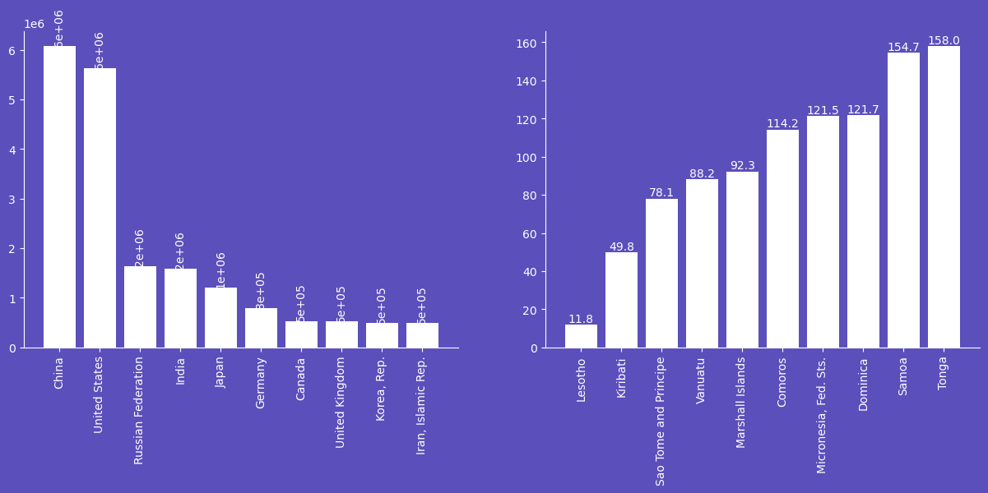
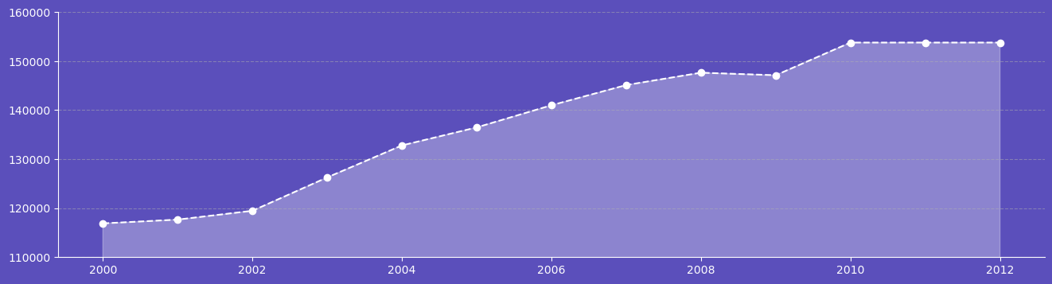
DATA ANALYSIS
Top 10 with highest CO2 Emissions
Bottom 10 with highest CO2 Emissions
CO2 Emissions
China and USA are the leading Country in CO2 Emissions
Lesotho is emitting lowest CO2 country
The CO2 Emissions is gradually increasing year by year
Energy Usage over years

Slide 24
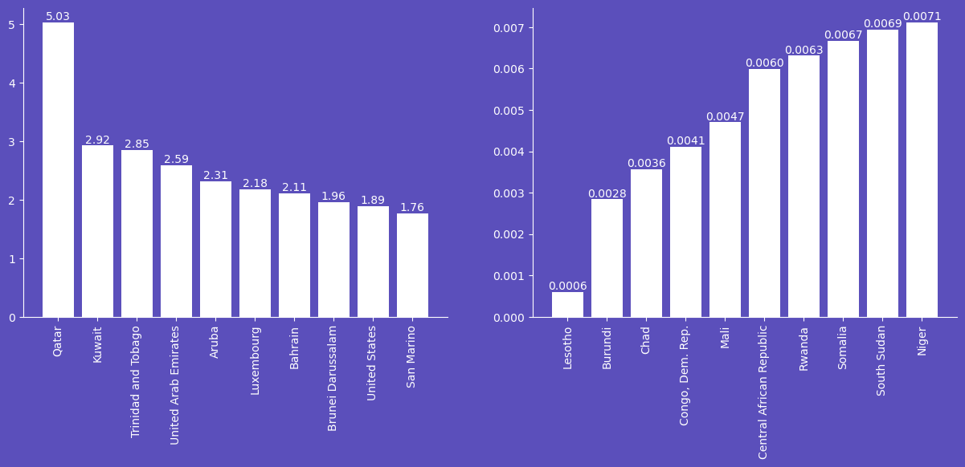
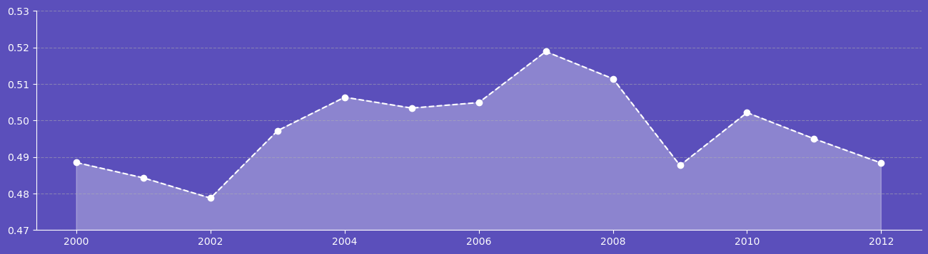
DATA ANALYSIS
Top 10 with highest CO2 Emissions/Capita
Bottom 10 with highest CO2 Emissions/Capita
CO2 Emissions/Capita
Qatar is the Country where avg citizen emits more CO2 than other Countries
San Marino with the one of the lowest Population Country is emitting on par compared to USA
Lesotho is the Country were citizens emits the lowest CO2
After 2008 the emissions of CO2 has started to decrease
CO2 Emissions/Capita

Slide 25
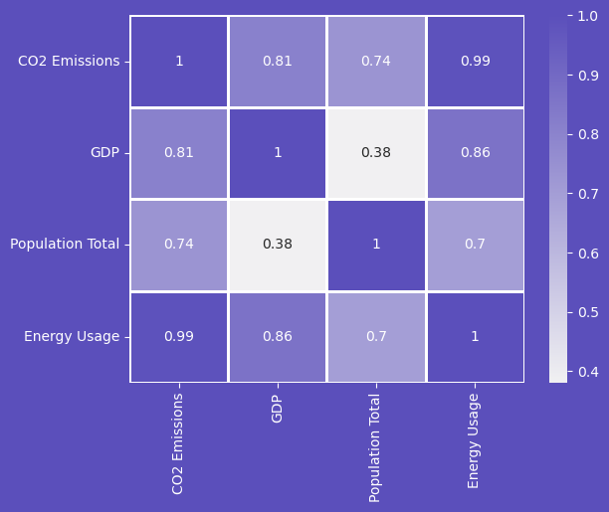
DATA ANALYSIS
Correlation analysis between GDP, Population Total, CO2 Emissions And Energy Usage
As the Energy Usage Increases the CO2 Emissions also increases
As GDP and Population Increase The CO2 emissions and Energy usage also increases
Country With Higher GDP emits more CO2 than countries with most Population
Country With Higher GDP uses mor energy than countries with most Population

Slide 26
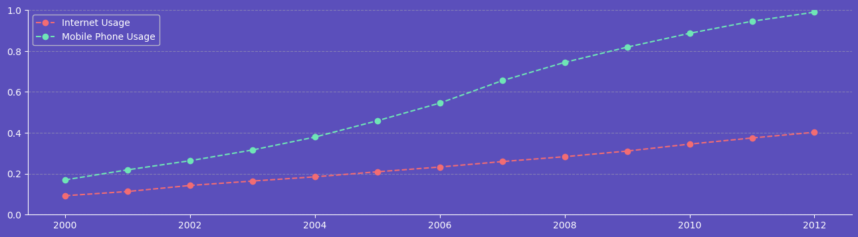
DATA ANALYSIS
Mobile Phone Usage vs Internet Usage
In early 2000s only 19% people had mobile and around 10% people used to use internet
As the year passed there was an increase in Mobile and Internet Usage
After 2004 more people started to use mobile
In 2012 around 100% population was using mobile but the internet usage was still around 40%
Even though people had mobile phones they do not have access to internet in 2012 around 60% people do not use internet

Slide 27
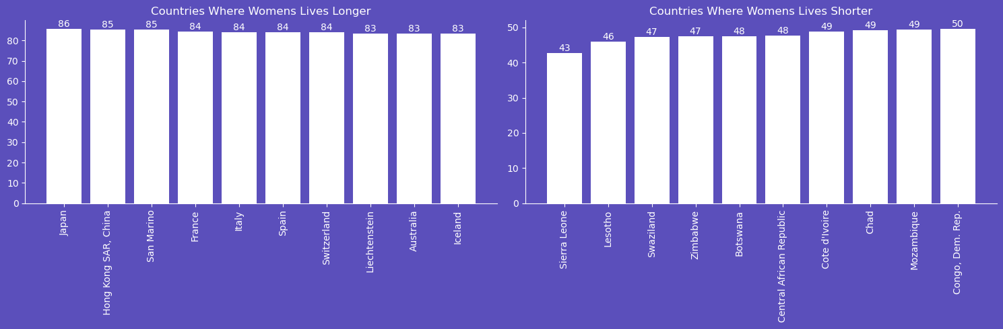
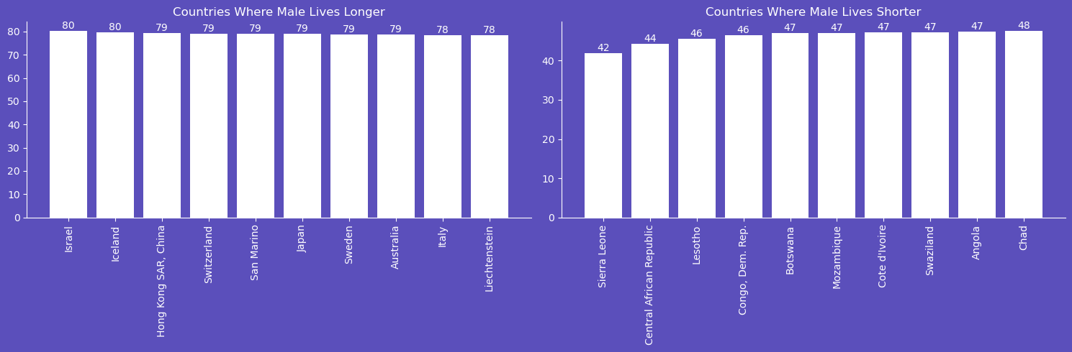
DATA ANALYSIS
In Japan Women lives around 86 years while in Sierra Leone
Women lives only 43 years on average
In Israel and Iceland men lives for 80 years on average,
In Sierra Leone men lives only 42 years

Slide 28
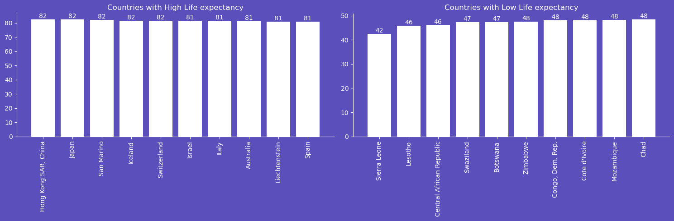
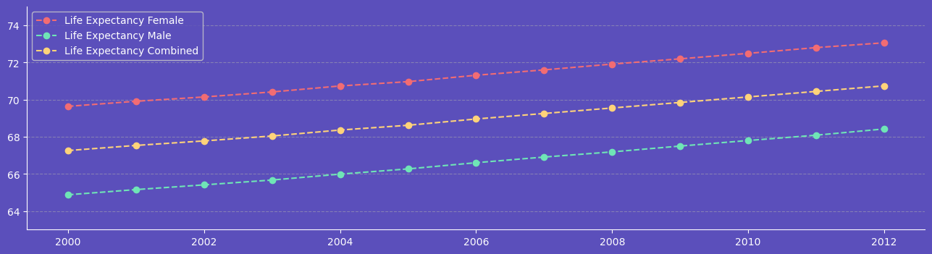
DATA ANALYSIS
Life Expectancy
The overall life Expectancy of Hong Kong, Japan San Monaco , Iceland, Switzerland are the countries where people lives the most
In Sierra Leone, an average person lives for only 42years
The Life Expectancy of females is greater than men in the world
Male vs Female vs Overall life Expectancy

Slide 29
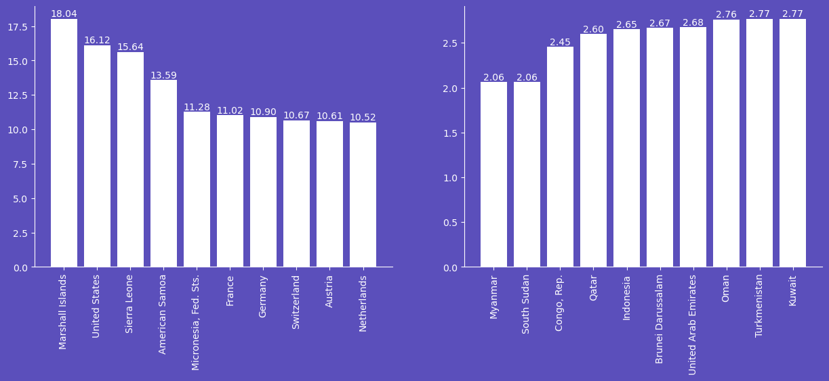
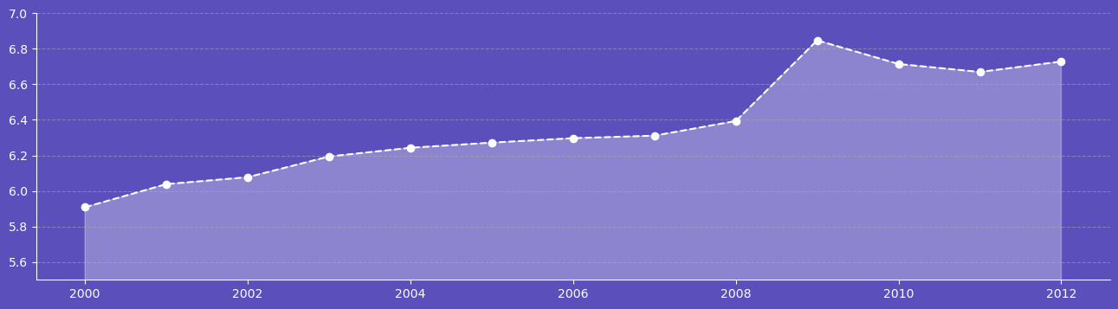
DATA ANALYSIS
Highest Health Exp % of GDP
Lowest Health Exp % of GDP
Health Exp % of GDP
Marshall Island spends most percentage of country’s Total GDP
Myanmar Spends only 2% of Country’s GDP on Health Care
Even though 2009 had economic crises the global Spend on health Care was still good
Health Exp % of GDP

Slide 30
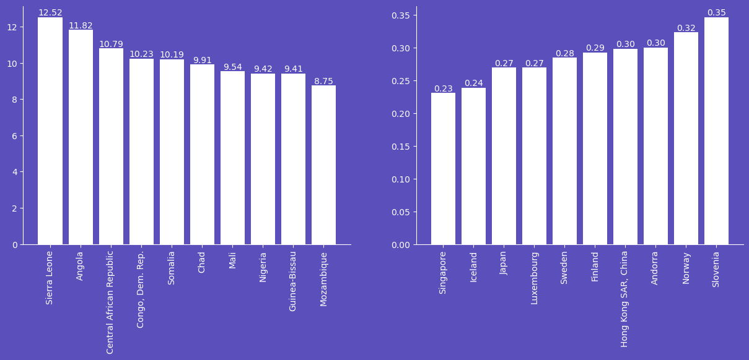
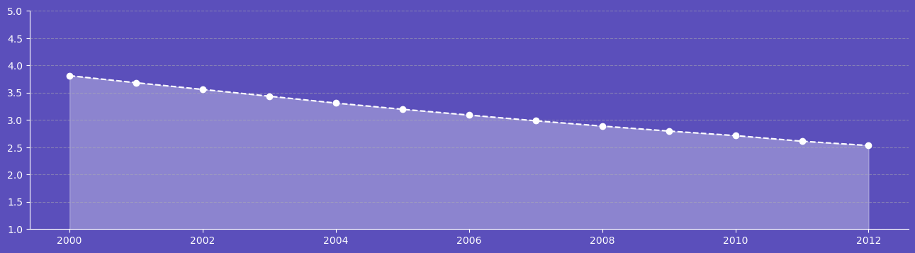
DATA ANALYSIS
Highest Infant Mortality Rate
Lowest Infant Mortality Rate
Infant Mortality Rate
Around 12.5% babies less than 1 year dies in Sierra Leone
Singapore has the lowest Infant Mortality Rate
Because of modern medical and increase in Spending on health care the Infant Mortality rate is decreasing
Infant Mortality Rate

Slide 31
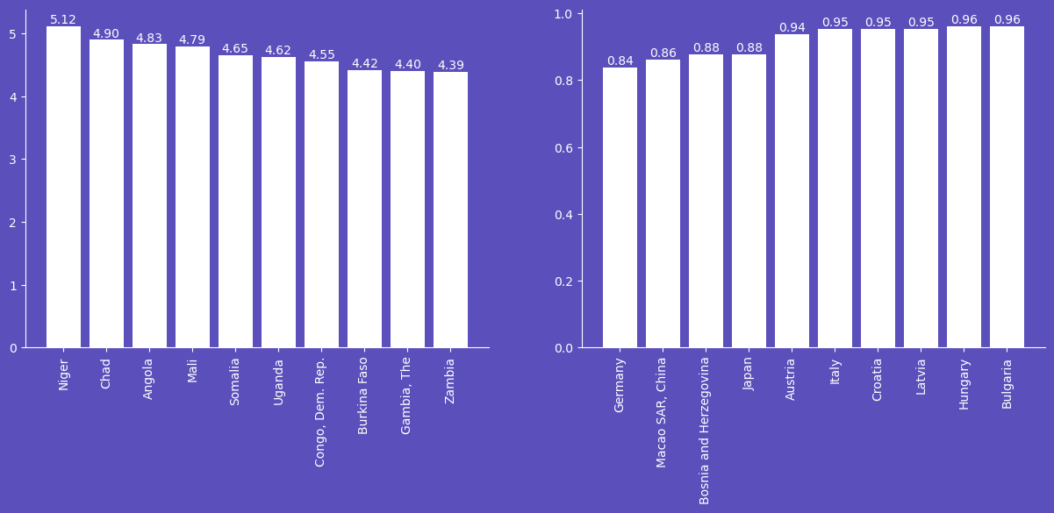
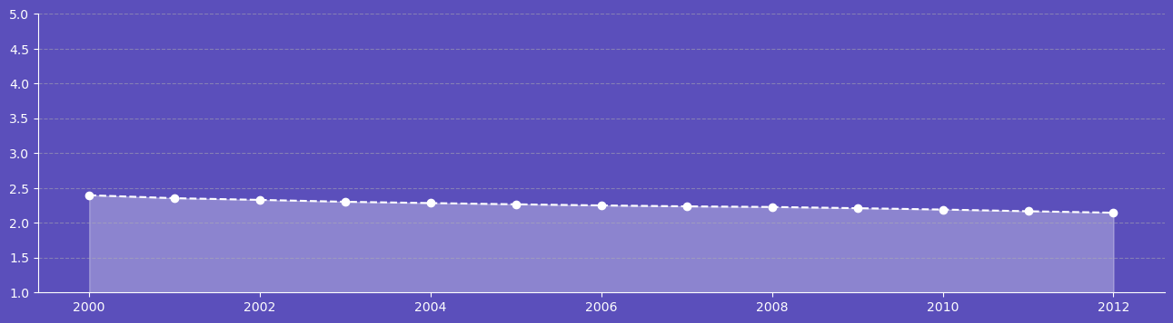
DATA ANALYSIS
Highest Birth Rate
Lowest Birth Rate
Birth Rate
Niger ha 5% Birth Rate which is highest
Germany has lowest Birth rate
The overall birth rate is world is decreasing slowly
Birth Rate

